Slide 1
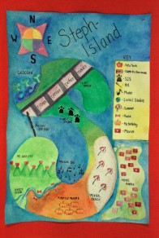
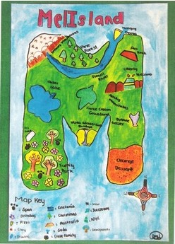
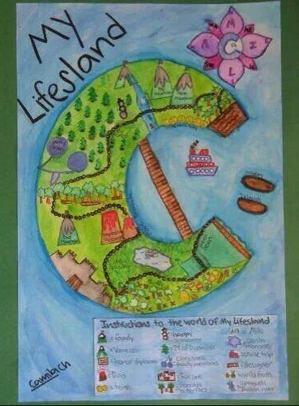
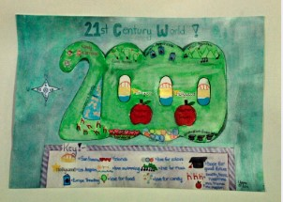
Autobiography Maps
Instructions
& Examples

Slide 2


We get it, we get it.
You’ve done a lot of “ice breaker” and “About You” assignments…
But we’re going to do another!
We’re going to create an Autobiography Map, something that allows us to practice map skills while also encouraging us to think about what matters most to us.
Every person’s map will look different. Do not worry if you have an idea that nobody else has!
Write in your agenda: Autobiography Map due FRIDAY, AUGUST 21.

Slide 3
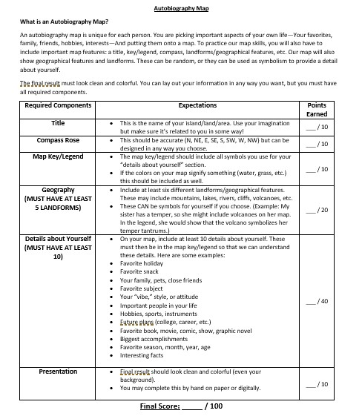
Autobiography Map Rubric
What is an Autobiography Map?
You’re creating a map of an entirely imaginary place—Your own land. You get to make the decisions.
The Rules:
-Include normal map features: Title, compass rose, key/legend
-Include 5 landforms or geographic features
-Include 10 details about yourself through symbols
-Should be colored
Write in your agenda: Autobiography Map due FRIDAY, AUGUST 21.

Slide 4
Autobiography Map Rubric
Map Features:
Title
  Name of your area; Should be the largest text on the map
Compass Rose
  Can be designed however you want to show your style/talent/mood
Map Key/Legend
  Should identify what all symbols on your map mean; Colors should be included if you chose that color to symbolize something. Geographic features/landforms should be included as well
Write in your agenda: Autobiography Map due FRIDAY, AUGUST 21.

Slide 5
Autobiography Map Rubric
Geography:
Just like a normal map, we need to show what your land looks like. Are you near oceans? Do you have rivers or plateaus or mountains? Waterfalls, deserts?
You will need FIVE of these landforms/geographic features.
You can use these as symbols for details about yourself. For example, I cry a LOT (happy, sad, doesn’t matter). I might fill my island with waterfalls! If you’re more chill and go with the flow, maybe you have many rivers.
IF these are used as symbols for yourself, you must say/show that in the map key.
Write in your agenda: Autobiography Map due FRIDAY, AUGUST 21.

Slide 6
Autobiography Map Rubric
Details about Yourself:
Here is where things get interesting!
Come up with 10 details about you that are so important that they’d make it onto a Map of You. All 10 details have to be shown by some symbol on the map. You are not limited to the suggestions on the rubric—Think outside of the box!
Examples: If you love chocolate milkshakes, maybe you’d draw an orchard of milkshake-growing trees. If your grandparents are a big part of your life, maybe you include their house or draw a statue of them.
Write in your agenda: Autobiography Map due FRIDAY, AUGUST 21.

Slide 7
Autobiography Map Rubric
Presentation:
No, you don’t have to present these to the class!
Your Autobiography Map should be colored and neat. Writing should be legible.
You can complete this digitally or on paper.
Write in your agenda: Autobiography Map due FRIDAY, AUGUST 21.

Slide 8
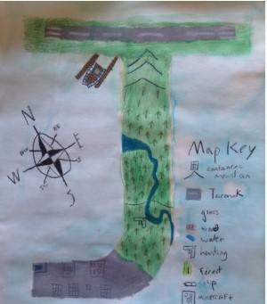
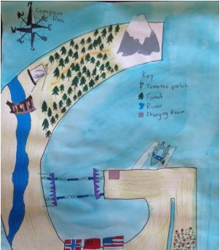
Examples
Here are some beautiful examples of autobiography maps! Don’t copy, but feel free to use these to get some ideas.
Missing Title
Not Enough Symbols
Can you guess what these two did wrong?

